Slide 1
Constraint Satisfaction Problem Methods for N-Queens

Slide 2
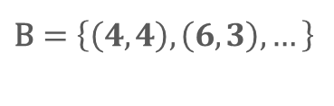
Early Implementation Ideas
Representing the Board
Complications
The board is a vector of integer pairs, where each pair represents the coordinates of a Queen.
The board must check the entire vector to know if a row/column is already taken.
What if the algorithm could access a row and know it has a Queen?
A board is checked for validity in its current state, but it has no idea if a board will inevitably fail.
What if we maintained the possible placements of each Queen, so we know instantly when a Queen no longer has any valid position?
Queens are always placed in the first available spot it sees.
→ What if we changed the order of placements to find a valid solution more efficiently?
 | 0 | 1 | 2 | 3 | 4 | 5 | 6 | 7
0
1
2
3 |  |  |  |  |  |  | ♕
4 |  |  |  |  | ♕
5
6
7
$$\text{B}=\left\{\left(4,4\right), \left(6,3\right), …\right\}$$

Slide 3
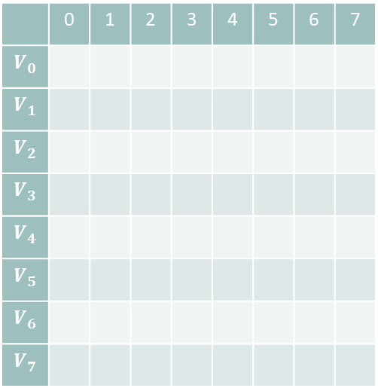

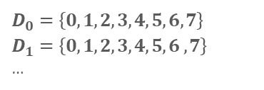
Implementation with CSP methods
Representing the Board
Backtracking
Manage each row as its own variable
Each Queen $V_{i}$has domain $D_{i}$ representing the columns it can be placed
Stacks: Depth-First-Search (LIFO)
DFS adds Queens to the board until failure.
When a board fails, the stack “backtracks” to a board pushed earlier:
Stack csp;
push initial board to csp
while (csp is not empty):
if (csp is complete) return csp
queen = next_queen()
for (each value in queen’s domain):
if (no conflicts with csp):
add value to new board
push board to csp
 | 0 | 1 | 2 | 3 | 4 | 5 | 6 | 7
$$V_{0}$$
$$V_{1}$$
$$V_{2}$$
$$V_{3}$$
$$V_{4}$$
$$V_{5}$$
$$V_{6}$$
$$V_{7}$$
$$D_{0}=\left\{0,1,2,3,4,5,6,7\right\}$$
$$D_{1}=\left\{0,1,2, 3, 4, 5, 6 ,7\right\}$$
…
It is much easier to implement CSP methods with Queen Variables based on rows than coordinate pairs!

Slide 4
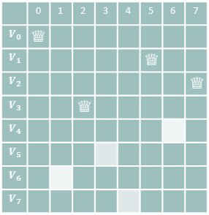
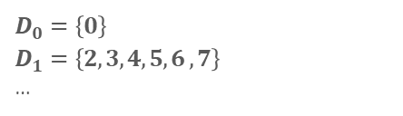
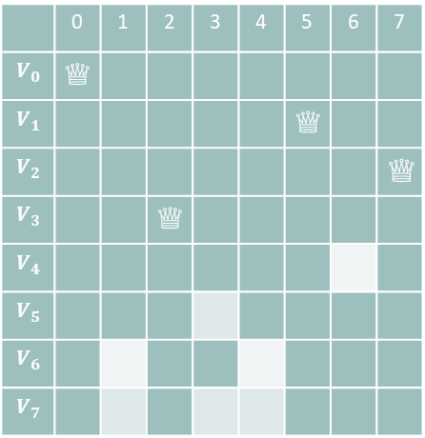
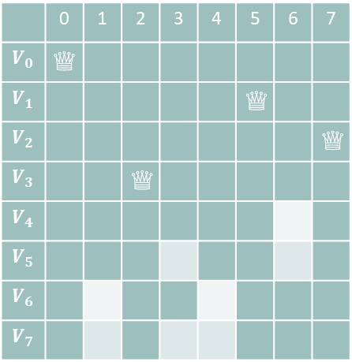
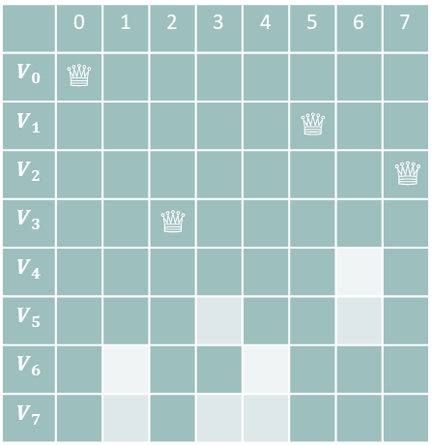
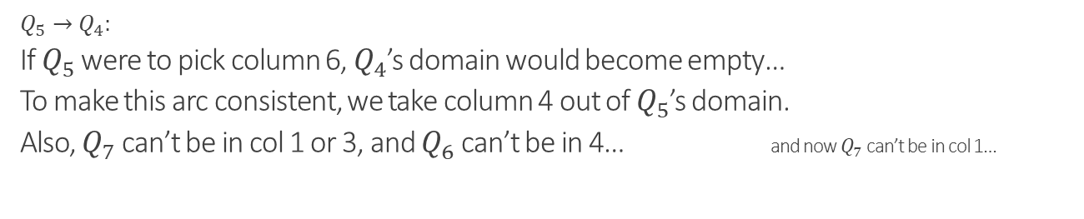

CSP Methods: Filtering
Forward Checking
Arc Consistency (Constraint Propagation)
An arc $Q_{i}→Q_{j}$ is consistent iff:
For all $i∈D_{i}$ there exists some $j∈D_{j}$ such that $Q_{i}$ and $Q_{j}$ don’t conflict.
Update domains of other Queens.
 | 0 | 1 | 2 | 3 | 4 | 5 | 6 | 7
$$V_{0}$$ | ♕
$$V_{1}$$ |  |  |  |  |  | ♕
$$V_{2}$$ |  |  |  |  |  |  |  | ♕
$$V_{3}$$ |  |  | ♕
$$V_{4}$$
$$V_{5}$$
$$V_{6}$$
$$V_{7}$$
 | 0 | 1 | 2 | 3 | 4 | 5 | 6 | 7
$$V_{0}$$ | ♕
$$V_{1}$$ |  |  |  |  |  | ♕
$$V_{2}$$ |  |  |  |  |  |  |  | ♕
$$V_{3}$$ |  |  | ♕
$$V_{4}$$
$$V_{5}$$
$$V_{6}$$
$$V_{7}$$
 | 0 | 1 | 2 | 3 | 4 | 5 | 6 | 7
$$V_{0}$$ | ♕
$$V_{1}$$ |  |  |  |  |  | ♕
$$V_{2}$$ |  |  |  |  |  |  |  | ♕
$$V_{3}$$ |  |  | ♕
$$V_{4}$$
$$V_{5}$$
$$V_{6}$$
$$V_{7}$$
 | 0 | 1 | 2 | 3 | 4 | 5 | 6 | 7
$$V_{0}$$ | ♕
$$V_{1}$$ |  |  |  |  |  | ♕
$$V_{2}$$ |  |  |  |  |  |  |  | ♕
$$V_{3}$$ |  |  | ♕
$$V_{4}$$
$$V_{5}$$
$$V_{6}$$
$$V_{7}$$
$$D_{0}=\left\{0\right\}$$
$$D_{1}=\left\{2, 3, 4, 5, 6 ,7\right\}$$
…
$$Q_{5}→Q_{4}:$$
If $Q_{5}$ were to pick column 6, $Q_{4}$’s domain would become empty…
To make this arc consistent, we take column 4 out of $Q_{5}$’s domain.
Also, $Q_{7}$ can’t be in col 1 or 3, and $Q_{6}$ can’t be in 4… and now $Q_{7}$ can’t be in col 1…

Slide 5
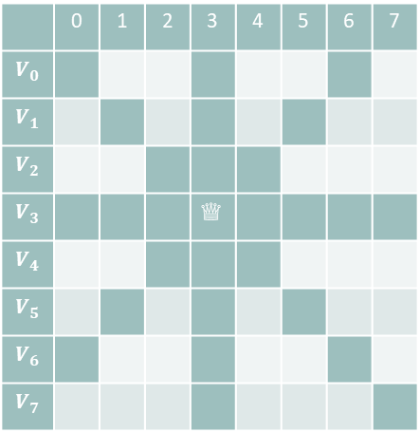
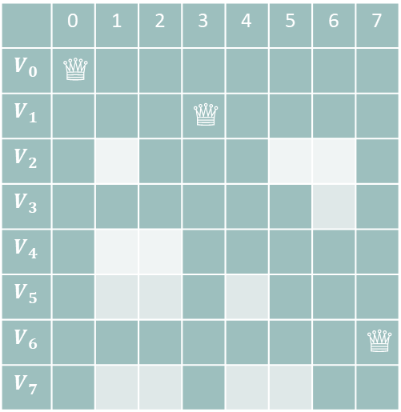
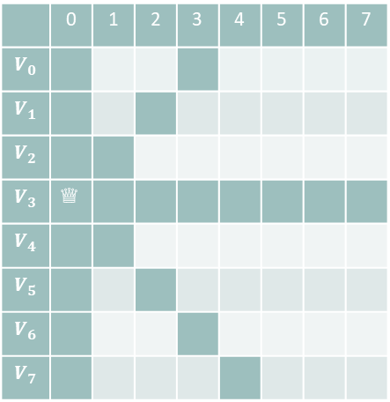
CSP Methods: Ordering
Minimum Remaining Values
Least Constraining Value
Pick the Queen with the smallest domain to place next
Pick the column placement that leaves the most possible placements for other Queens
 | 0 | 1 | 2 | 3 | 4 | 5 | 6 | 7
$$V_{0}$$ | ♕
$$V_{1}$$ |  |  |  | ♕
$$V_{2}$$
$$V_{3}$$
$$V_{4}$$
$$V_{5}$$
$$V_{6}$$ |  |  |  |  |  |  |  | ♕
$$V_{7}$$
 | 0 | 1 | 2 | 3 | 4 | 5 | 6 | 7
$$V_{0}$$
$$V_{1}$$
$$V_{2}$$
$$V_{3}$$ |  |  |  | ♕
$$V_{4}$$
$$V_{5}$$
$$V_{6}$$
$$V_{7}$$
 | 0 | 1 | 2 | 3 | 4 | 5 | 6 | 7
$$V_{0}$$
$$V_{1}$$
$$V_{2}$$
$$V_{3}$$ | ♕
$$V_{4}$$
$$V_{5}$$
$$V_{6}$$
$$V_{7}$$
Note that the search problem won’t update domains without some level of filtering.
Restricts 20 other placements…
… only 14 placements ♕

Slide 6
Performance: board size n = 25
Original
FC
ARC
Execution time:
23,652.4 ms
Nodes expanded:
1,216,776 nodes
Execution time:
833.378 ms
Nodes expanded:
19,097 nodes
Execution time:
857.581 ms
Nodes expanded:
2,547 nodes
MRV
Execution time:
25,458.3 ms
Nodes expanded:
1,216,776 nodes
Conclusion:
MRV & LCV suck…?
Without filtering, MRV behaves the exact same as picking Queens in sequential order.
Similarly, LCV is worse because it wastes time deciding where to place a Queen.
LCV
Execution time:
489,112 ms
Nodes expanded:
20,589,670 nodes

Slide 7
Performance: board size n = 25
Original
FC
ARC
Execution time:
23,652.4 ms
Nodes expanded:
1,216,776 nodes
Execution time:
833.378 ms
Nodes expanded:
19,097 nodes
Execution time:
857.581 ms
Nodes expanded:
2,547 nodes
MRV
MRV + FC
MRV + ARC
Execution time:
25,458.3 ms
Nodes expanded:
1,216,776 nodes
Execution time:
9.402 ms
Nodes expanded:
214 nodes
Execution time:
17.48 ms
Nodes expanded:
59 nodes
LCV
LCV + FC
LCV + ARC
Execution time:
489,112 ms
Nodes expanded:
20,589,670 nodes
Execution time:
22.95 ms
Nodes expanded:
412 nodes
Execution time:
19.19 ms
Nodes expanded:
55 nodes

Slide 8
Performance: board size n = 25
Original
FC
ARC
Execution time:
23,652.4 ms
Nodes expanded:
1,216,776 nodes
Execution time:
833.378 ms
Nodes expanded:
19,097 nodes
Execution time:
857.581 ms
Nodes expanded:
2,547 nodes
MRV
Execution time:
25,458.3 ms
Nodes expanded:
1,216,776 nodes
MRV + LCV + FC
MRV + LCV + ARC
LCV
Execution time:
3.24645 ms
Nodes expanded:
26 nodes
Execution time:
8.94307 ms
Nodes expanded:
26 nodes
Execution time:
489,112 ms
Nodes expanded:
20,589,670 nodes

Slide 9
Performance: board size n = 25

Slide 10

Performance: Demo size n = 30
ARC + MRV + LCV
Execution time:
27.45 ms
Nodes expanded:
38 nodes

Slide 11
Performance: Time Taken Moving Average

Slide 12
Performance: Storage Moving Average

Slide 13
Observations
Time
Nodes Expanded
FC is faster than ARC?
ARC spends more time propagating through domains
LCV isn’t always an improvement?
On large boards, LCV can take longer to sort domains than FC+MRV alone takes to visit a lot of boards
MRV vs LCV?
While LCV costs time to sort domains, our solver easily knows the size of each Queen’s domain
MRV is powerful because it “fails fast,” and we only need a single solution.
ARC visits less nodes than FC?
ARC will eliminate more possible boards than FC without having to visit them
A combination of ARC+MRV+LCV will visit a consistently low number of boards
However, it’s still expensive to compute…
In general, as the board size increases, there will be a lot more variation in how long the algorithm takes to find a solution:
The solver is still able to get a solution on the first try, but the number of possible placements is still increasing quadratically - as well as the upper limit of how long it might take.

Slide 14
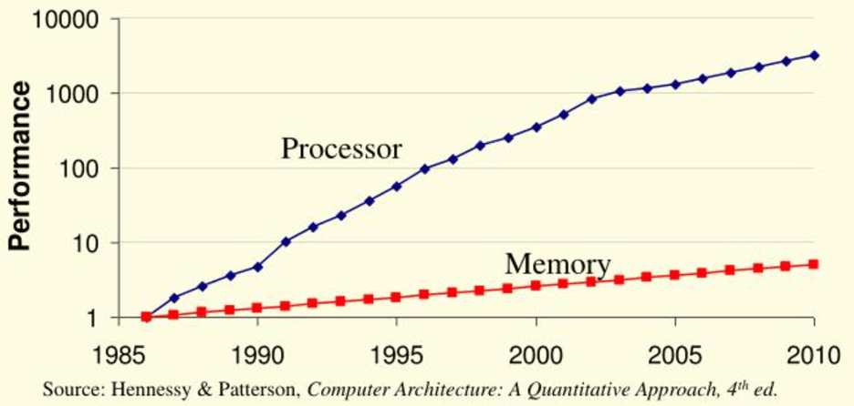
Memory or Time?
The Memory Bottleneck
While FC may be faster in a lot of situations, time is a theoretically infinite resource.
Memory, however, is not.
While you might be able to afford to wait 1,000,000 years, you may not even have the hardware to run an algorithm that demands too much space.

